Slide 1
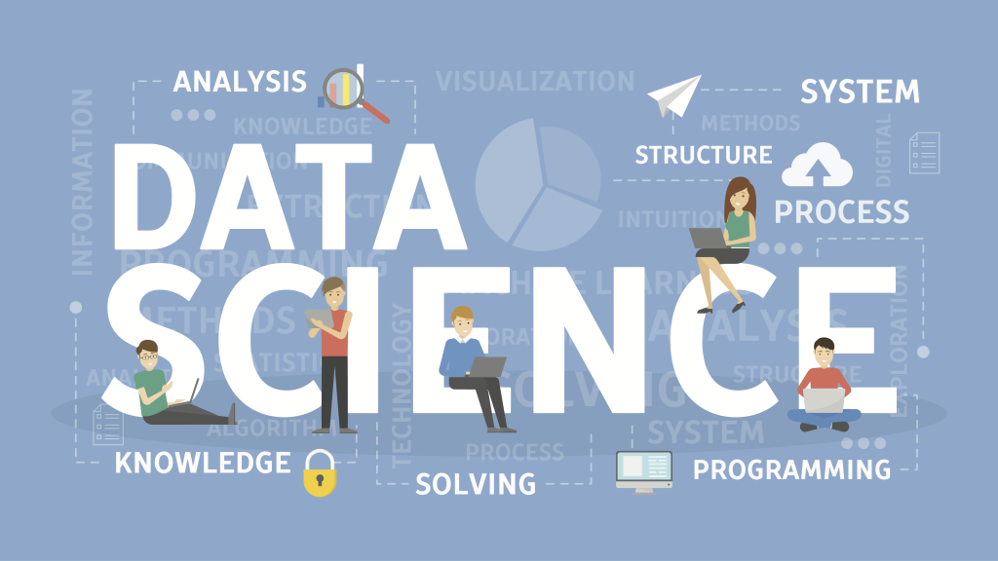
SHIELD TECHNOLOGIES
By:
Raju

Slide 2
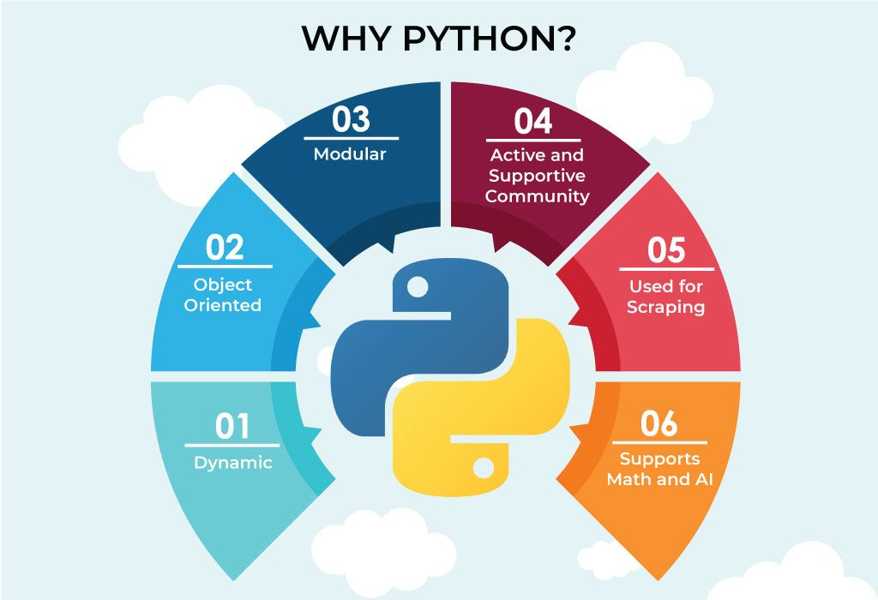
Why Python

Slide 3
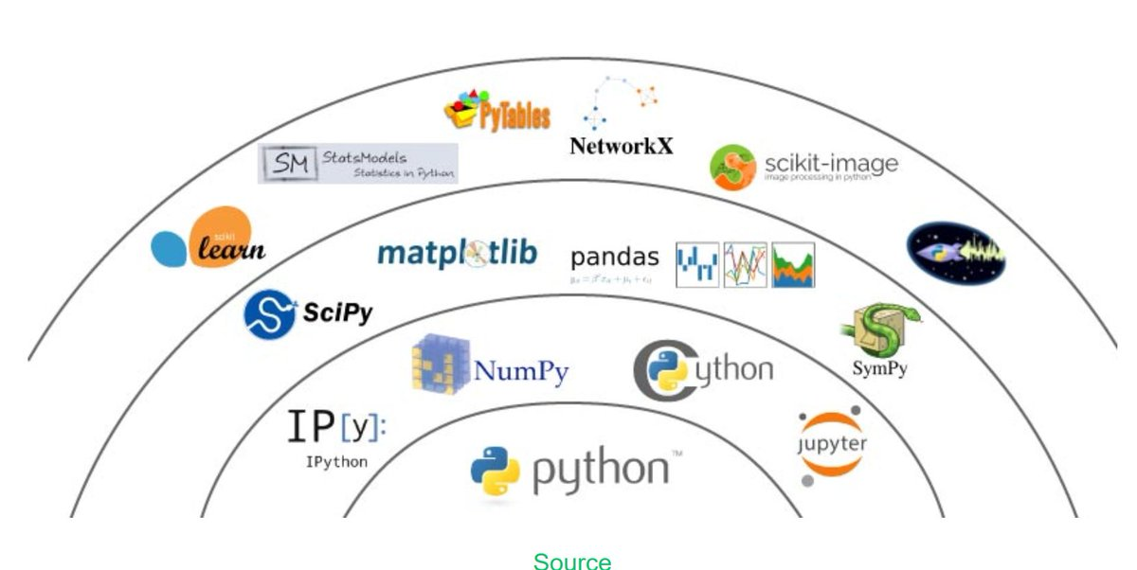
Python For Data Science

Slide 4
Applications

Slide 5
THANK YOU

